Slide 1
Welcome to our presentation

Slide 2
Presentation Presented by
Mahmudul islam
ID NO:15-01-04-073
Musad AL Rubayet
ID NO:15-01-069
MD.Jahid Shah Shiamun
ID NO:15-01-04-071

Slide 3
INTRODUCTION
This is our first work on Software Development. We wanted to create something new. We tried our best. We tried to develop a gaming project. The name of our game is “STUPID ZOMBIES”. Basically, this is a shooting game. The idea was to kill the zombies before they touch the ground . Our hero is a zombie hunter . His mission is to kill the zombies and save the city from zombies.

Slide 4
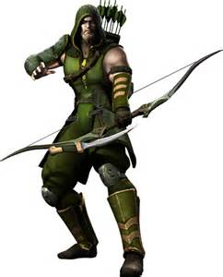
POKE
SHOOTER

Slide 5
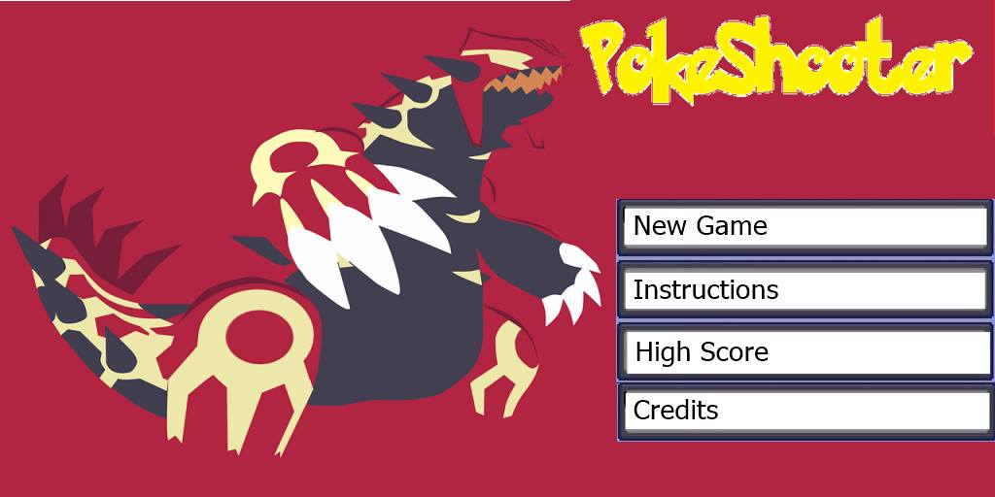
Menu
New game
Instructions
High Score
Credits

Slide 6
Features
The following features included in our game
Hero (he can up left and down).
Weapon (arrow can be thrown in multiple angles).
Enemies (multiple pokes will come at a time).

Slide 7
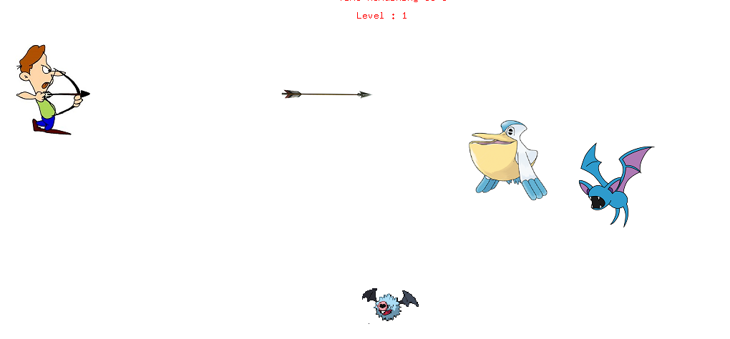
Game Environment

Slide 8
INSTRUCTIONS :
Move the mouse up and down to move the archer.
Click LMB to throw arrow . You can throw second arrow after your first arrow have hit the wall. Click RMB to throw second arrow.
Try to hit as many pokemon as possible.
Difficulty and level will change as you collect more points.

Slide 9
HIGH SCORE
PROTTUS 357
MAHMUD 293
RUBAYET 288
SAIF 247
JEASUN 219

Slide 10
UPCOMMING FEATURES
Developing in graphics.
Increasing level.
Increasing difficulty.

Slide 11
SPECIAL THANKS TO OUR RESPECTED TEACHER
AND
THANK YOU ALL FOR WATCHING OUR PRESENTATION .

